Slide 1
CS 794: Project Lab Group 1 Reversible Circuit Simulator
Akansha Ganeriwal
14400112032
Aparajita Paul
14400112037
Poulami Roy
14400112057
Supervised by Prof. Bappaditya Mondal
Department of Computer Science and Engineering Neotia Institute of Technology, Management & Science November 2015 7th Semester 2012-2016 Batch

Slide 2
Contents
Project Overview
Background Study
Analysis & Solution
Design
Target vs. Achievement – 7th Semester
Plan of work – 8th Semester
Conclusion

Slide 3
Project Overview
Design a simulator to draw and test reversible circuits.
Give the user the freedom to implement any reversible circuit and also to edit and delete the circuit.

Slide 4
Background Study
One of the emerging research areas in quantum computing involves synthesis and testing of reversible logic circuits.
Management of energy loss is an important issue in digital logic design for the customer.
Information lossless-ness due to reversibility may lead to zero-energy dissipating circuit realization in the ideal case.

Slide 5
Background Study
A reversible circuit has equal number of inputs and outputs, and maps each input vector to a unique output vector and vice-versa.
RevSim unlike other simulators gives the user the freedom to implement any reversible circuit and also to edit, delete and show the Boolean expression of the circuit.
The proposed work focuses primarily on the testing of reversible circuit constructed with CCNOT gates (Toffoli gates).

Slide 6
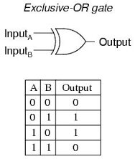
Background Study
Irreversible Circuit:
An irreversible circuit is a circuit whose inputs cannot be reconstructed from its outputs.

Slide 7
Background Study
Disadvantages:
We can say that the common irreversible gates like AND, OR, NOR and NAND erases one bit of information on every operation.
Consequently each bit of lost information will lead to the release of at least kTln2 amount of heat. This leads to increase in entropy.

Slide 8
Background Study
Reversible Gate:
Defined as set of target and control lines such that there may or may not be control line but there has to be one target line for each reversible gate
Reversible gate is g(C,T) where C is set of control lines and T is set of target lines such that C∩T= ᶲ and T≠ ᶲ

Slide 9
Background Study
The output lines always have an unique combination that is used to determine the inputs given to the circuit correctly.
In reversible logic, we need to consider another important parameter, namely the number of garbages.
Ex: Toffoli Gate, Fredkin Gate, Feynman Gate.

Slide 10
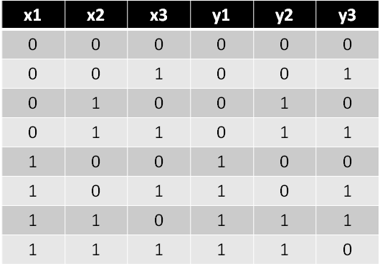
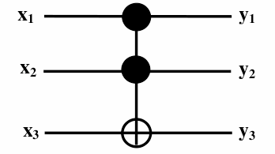
Background Study
Toffoli Gate:
Reversible gate with set of control and target points
The output are uniquely mapped to the inputs
It is also called control-control-not gate
Toffoli Gate
Truth Table

Slide 11
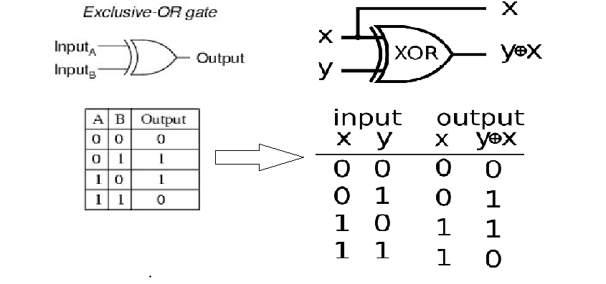
Background Study
Conversion of Irreversible to Reversible XOR:
Irreversible XOR
Reversible XOR

Slide 12
Background Study
Reversible Logic Circuit:
Number of input line is equal to number of output lines
Maps each input pattern to a unique output pattern
An n-input, m-output Boolean function F is said to be reversible if and only if m = n, and F is one-to-one
A
Irreversible
Logic Circuit
A
Reversible
Logic Circuit
P
P
B
B
Q

Slide 13
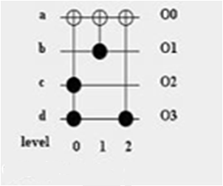
Background Study
Reversible Benchmark Circuit Using Toffoli Gates:
Number of Lines: 4
Number of Gates: 3

Slide 14
Analysis & Solution
The following are required for RevSim which is being developed as a solution to the analysis the problem of irreversible circuits:
Language Used: Java (Swing)
Hardware Used: Intel ® Core ™ i3-3110M CPU @ 2.40 GHz
4.00 GB RAM
Software Used: 64bit Windows 8 OS
Netbeans IDE

Slide 15
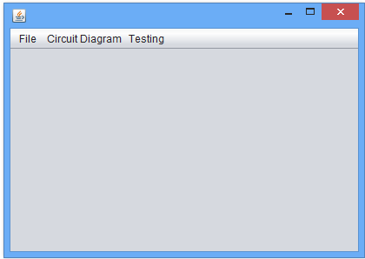
Design
Basic Module
The main user interface is the basic module of the application.The main user interface includes the buttons and label for the main application page. It is the main interface from which other part of the application is linked.
Fig.1: Main user interface of the system.

Slide 16
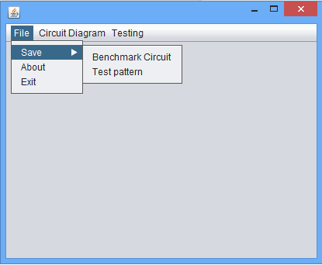
Design
It has following menu button and sub menu:
A.File:
The file menu provides two submenus Save, About and Exit.
Fig. 2: The file menu & its submenus

Slide 17
Design
B. Circuit Diagram
Circuit diagram is an essential feature of our simulator RevSim. RevSim can display any reversible logic circuit having any number of lines and any number of gates.
Input: The input to the circuit diagram is number of lines, number of gates to draw, set of target and control position.
Output: The circuit diagram is the output for given input.

Slide 18
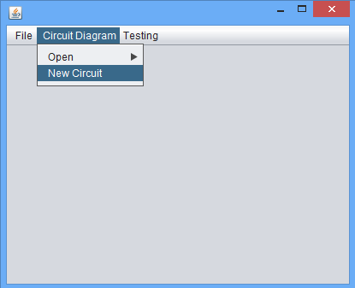
Design
New Circuit:
Fig.3: New Circuit drawing
The New Circuit option is selected for drawing
a circuit diagram.

Slide 19
Design
This option helps user to draw new circuit by providing input details as such number of lines and number of gates to draw. This also provides user the option to give input to the circuit by providing set of target and control manually.

Slide 20
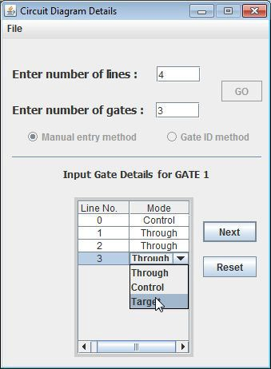
Design
Fig. 4: Manual Entry
Input is given in the form of number of lines and gates and details are provided for each gate.

Slide 21
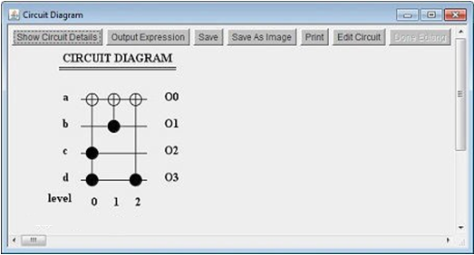
Design
Open Circuit:
This option provides further flexibility to user for opening already saved circuit or from the set of benchmark circuit available with the application.
Fig.5: Circuit diagram of the input provided by the user

Slide 22
Target vs. Achievement- 7th Semester
Target set:
Drawing the circuit with Toffoli gates using Manual Entry method.
Achievement:
Graphical representation of an intersection of horizontal lines and vertical lines taken as input. The input to the control, target and through lines have not been given. Hence the gates could not be placed along the coordinates.

Slide 23
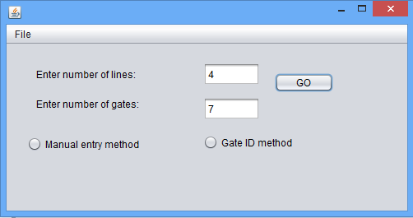
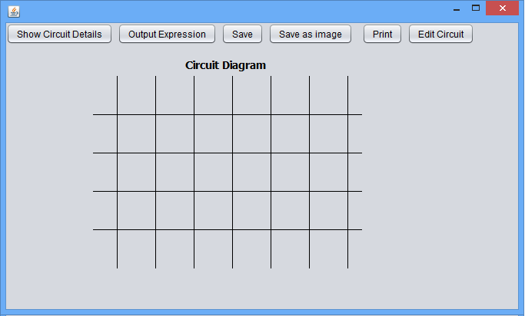
Target vs. Achievement- 7th Semester
Input in the form of number of lines and gates taken from user.
Fig. 6: Input form
Output as a graphical representation of an intersection of 4 horizontal lines and 7 vertical lines
Fig. 7: Output

Slide 24
Plan of Work-8th Semester
Month | Plan of Work
Within February | Drawing the circuit with Toffoli gates using both Manual Entry and Gate ID method.
Within March | Saving circuit diagram as image and opening the saved circuit.
Within April | All submenus under the “Open” menu will be completed. Eg: Adders, Cycle Functions etc.
Within May | Single Missing Gate Fault will be tested.

Slide 25
Conclusion
An irreversible circuit can be converted to reversible circuit by making the number of input lines equal to the number of output lines where the newly added output lines are called Garbage Output.
The output lines always have an unique combination that is used to determine the inputs given to the circuit correctly, eliminating loss of information.

Slide 26
References
R. Feynman. Quantum mechanical computers. In Optic News, volume 11(2) pages 11 20, 1985.
D. Maslov and G. W. Dueck. Garbage in reversible design of multiple output functions. In Proc. of 6th International Symposium on Representations and Methodology of Future Computing Technologies, pages 162-170, March 2003.

Slide 27
Thank You

